Slide 1
ITAI 4373 presentation
Jeran Kilpack

Slide 2
This is just a basic presentation to show off what I worked on for this course

Slide 3
A02 and Lo2
These were theoretical business use cases of integrating AI in a real world environment and what businesses need to worry and think about.

Slide 4
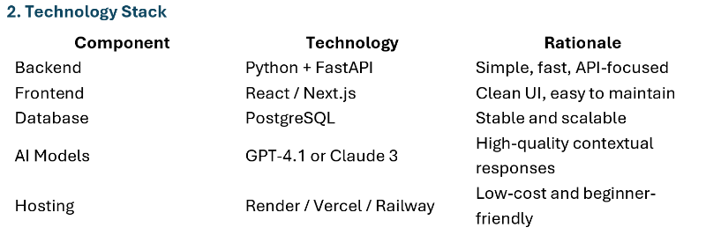
Midterm and Final
The main bulk of the course was working on a platform for a client to help him use AI for his art business.

Slide 5
Final dashboard.
Deploying a proof of concept was very tricky. I needed to decide my platforms for the front end and back end. In the end I got a working dashboard (that was very plain) and with a real actual big team in the field I could see the value of how this could help clients with businesses to integrate AI into their workflow.

